Slide 1

EDA ON MEDICAL COST PREDICTION

Slide 2
About me:
Relangi Kavya Sri
MBA(Finance)
"I want to learn Data Science because I'm curious about how we can use info to solve problems and make life better. Data Science gives us tools to look at data, find patterns, and make smarter choices, leading to cool new ideas that help us all.“
Linkedin link: https://www.linkedin.com/in/kavyasrirelangi

Slide 3
Agenda:
Business Problem and Use case domain understanding(If Required)
Objective of the Project
Summary of the Data
Exploratory Data Analysis:
Data Cleaning Steps
Data Manipulation Steps
Univariate Analysis Steps
Bivariate Analysis Steps
Key Business Question
Conclusion (Key finding overall)
Q&A Slide
Your Experience/Challenges working on Web Scraping – Data Analysis Project.

Slide 4
BUSINESS PROBLEM:
Insurance companies need to set the insurance premiums following the population trends.
The aim here will be to predict the medical costs billed by health insurance on an individual given some features about the individual in the dataset.
OBJECTIVE:
The goal of medical cost prediction is to estimate how much a person's healthcare will cost in the future. This involves looking at things like their age, health history, lifestyle habits, and how often they typically need medical care. By using this information to make educated guesses about future medical expenses, we can help insurance companies set fair prices for coverage, healthcare providers plan for the needs of their patients, and individuals budget for their own healthcare costs. It's like trying to predict how much money you might need for medical bills down the road, so you can be prepared.

Slide 5

SUMMARY OF THE DATA:
Source dataset is in CSV format.
Dataset contains 1338 rows and 7 columns.
There is no missing values and null values for the provided input dataset.
There is only one duplicate value in the dataset which is having index number 581.
Exploratory Data Analysis (EDA) is an approach to analyse datasets & to summarize their main characteristics , often with visual methods.

Slide 6
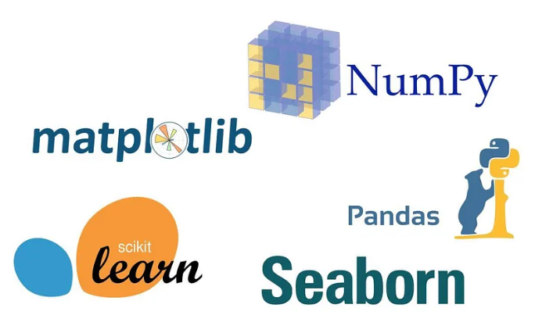
REQUIRED LIBRARIES & MODULES:
Pandas
Matplotlib
Seaborn
Scikit-learn
Sklearn.modelselection
Sklearn.preprocessing
Sklearn.metrics

Slide 7
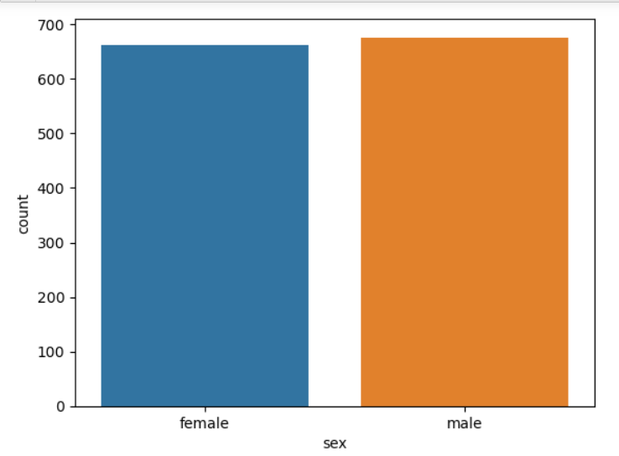
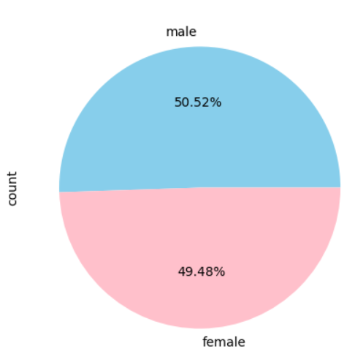
From Count and pie plot the male gender has a slightly larger population, but the population of males and females are nearly equal.

Slide 8
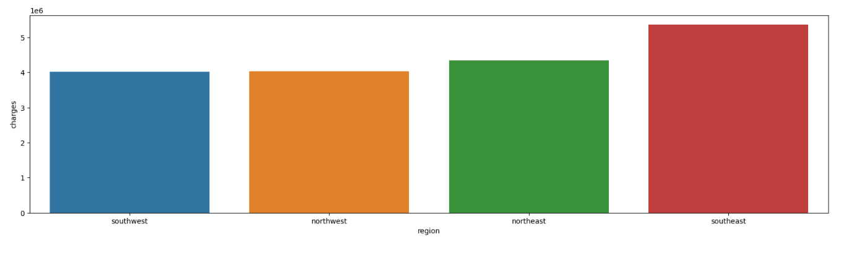
The highest amount of charges are in the Southeast while the lowest are in the Southwest.

Slide 9
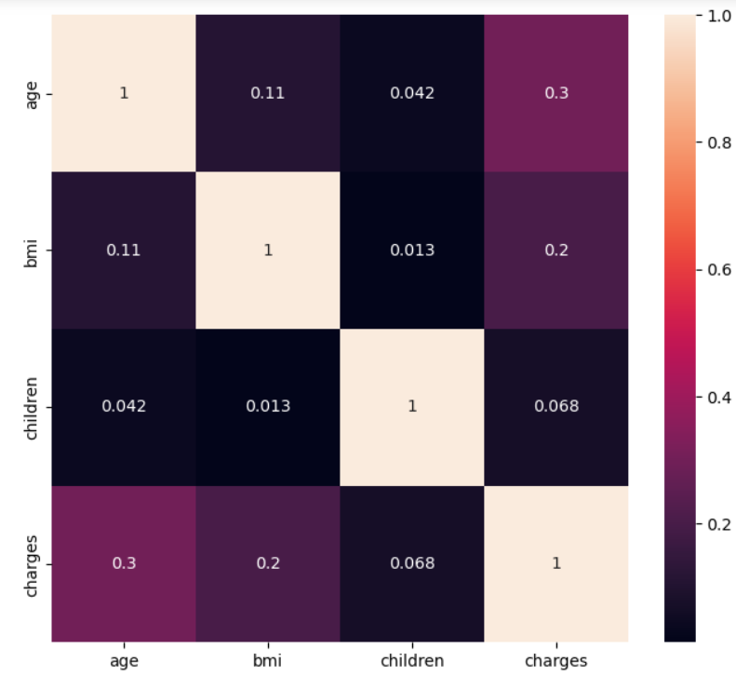
There is a strong correlation between age and the target variable charges.
A positive correlation of 0.3 suggests that as age increases, charges tend to increase as well.

Slide 10
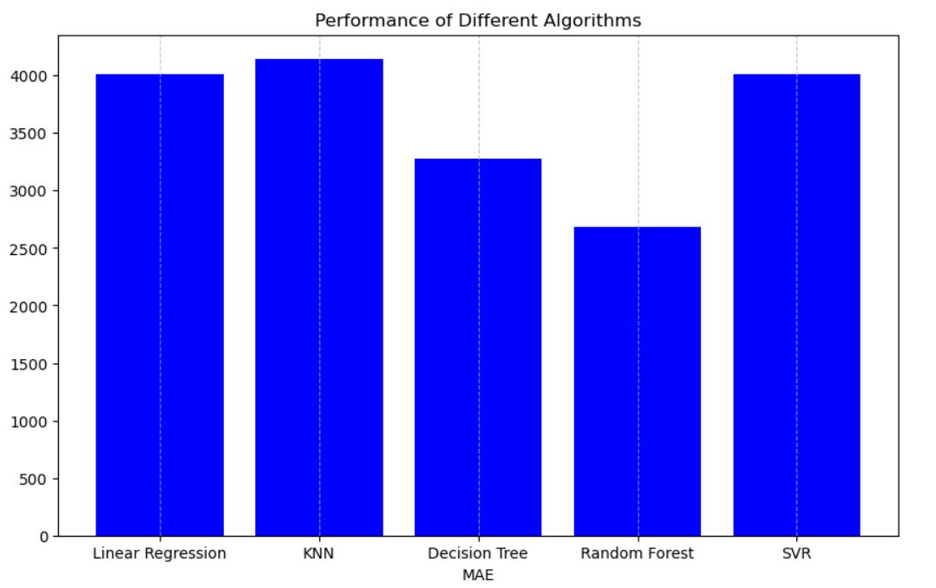
CONCLUSION:
After completion of end-to-end machine learning project using Churn data. Able to clean the data and visualize the data by visualization and understand the insights of the data. Then able to build a machine learning mode, transformed the categorical to numerical feature. After transforming the data applied 6 different algorithms. Finally Logistic regression obtaining accuracy 0.812606 high among another model when compared.

Slide 11


